Slide 1



Savvy Care Skincare Refill Management Tool
Jin Yan
Insight DS Fellow

Slide 2
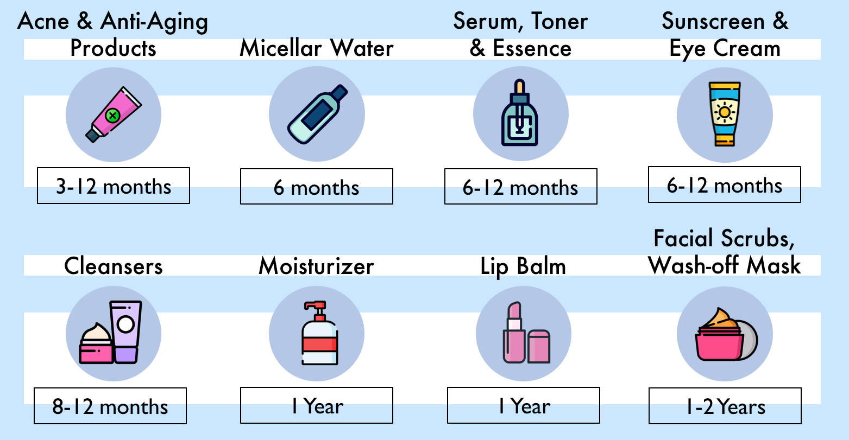
What is Savvy Care?
Leverage ML models for discount estimation to support cost reduction and purchasing decisions.
Beauty maintenance cost:
Long shelf life:
$313 per month
$3756 per year
$225,360
lifetime
The Average Cost of Beauty Maintenance Could Put You Through Harvard!
www.SavvyCare.com

Slide 3



Rich dataset on Past Skincare Discounts
Data Source
Data Preparation
Modeling
Feature Engineering
Deliverables
Top 12 popular skincare brands
Discount info from 2010 – 2020
Data source: dealmoon.com
Web Scraping: Selenium

Slide 4
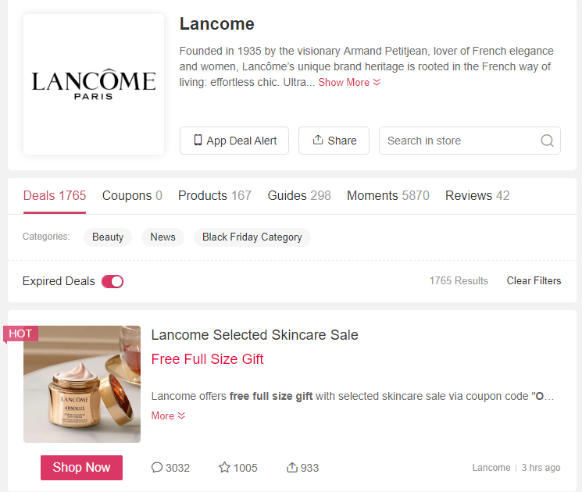



From Raw Data to Prediction
Data Source
Data Preparation
Modeling
Feature Engineering
Deliverables
Labels:
Gift with purchase (GWP)
% off
Discount
next week?
Gift?

Slide 5
From Raw Data to Prediction
Data Source
Data Preparation
Modeling
Feature Engineering
Deliverables
Calendar Features
Year, month, day
Weekend or not
Lag Features
Discount past 1 month/2 month
Historical
Statistics
average of same days from historical years
A week from holiday or not
GWP 1 month/2 month

Slide 6
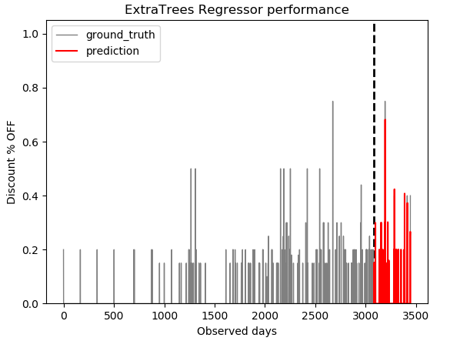
Predicting the Future % OFF
Data Source
Data Preparation
Modeling
(Regression)
Feature Engineering
Deliverables
2010
2020
Data
RMSE1
RMSE2
Model Performance:
Average RMSE
RMSE3
…
RMSEn
Train
Validation
Test
Methods | Naïve Forecast | LGBM
RMSE | 0.00269 | 0.00012
96% improvement

Slide 7
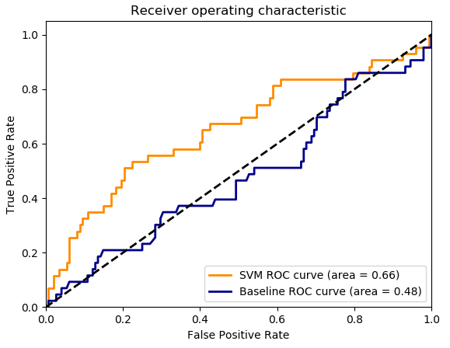
Predicting If GWP
Data Source
Data Preparation
Modeling
(Classification)
Feature Engineering
Deliverables
Challenge: extremely imbalanced, 5% occurrence of True GWP
Stratification with k-fold
Resampling to get more balanced data
Baseline: Logistic Regression
SVM improves area under ROC curve 38%

Slide 8

The secrete of skincare discount!
Data Source
Data Preparation
Modeling
(Classification)
Feature Engineering
Deliverables
The benefits of using Savvy Care:
Fun facts:
Saves time
Saves money
I know I find the best deal
I know when should I refill my skincare
Deals usually happen in weekdays!
Memorial Day has better deal than Christmas
Giving 15% OFF is not good enough compared with GWP
Deals are coming more frequently these years

Slide 9








About Me: Jin Yan
https://www.linkedin.com/in/jyan83/
Masters in Computer Science
& Civil Engineering
yankaron@gmail.com
PhD in Civil Engineering

Slide 10
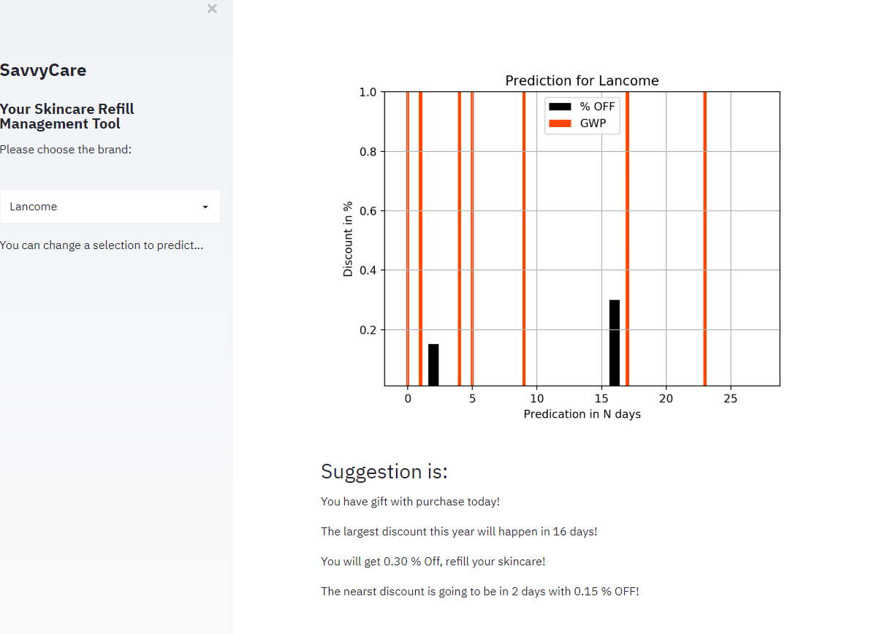

Slide 11
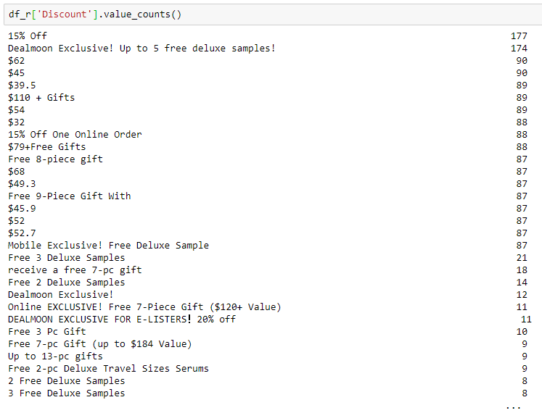
Problem framing
Notes:
Inputs vs. Outputs
Endogenous vs. Exogenous
Unstructured vs. Structured
Regression vs. Classification
Univariate vs. Multivariate
Single-step vs. Multi-step
Contiguous vs. Discontiguous

Slide 12
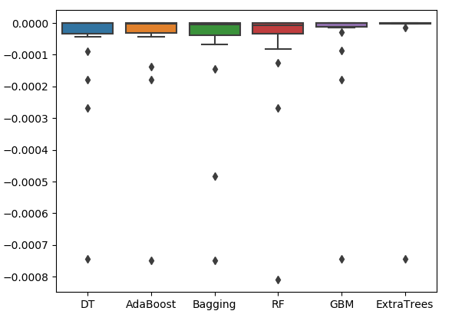
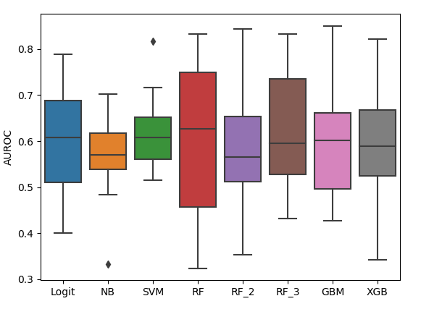
Model Selection

Slide 13
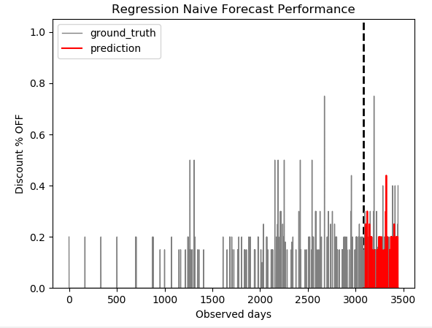
Regression improvement

